Slide 1




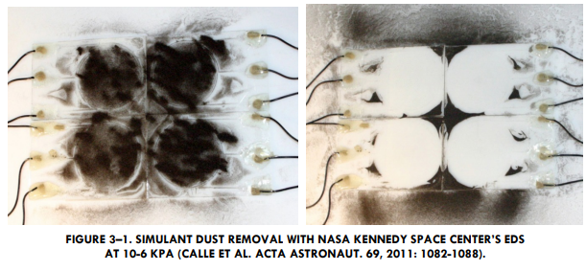
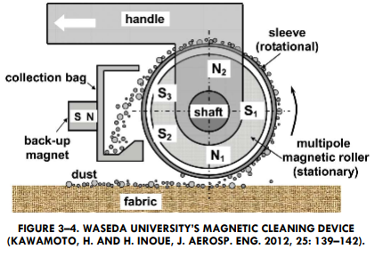
INTRODUCTION
Problem and Existing Solutions
AIAA Caltech Student Branch – 11/18/20
EASE Preliminary Design Review
Problems Caused By Spacesuit Dust Ingress Into Habitable Volumes
Increased loads on in-cabin dust mitigation technologies
Incorrect readings during in-cabin experiments
Performance reduction and possible failure of in-cabin equipment
Astronaut health risks
Dust brought to Gateway and Orion when lander returns to lunar orbit
Existing Solutions

